Slide 1
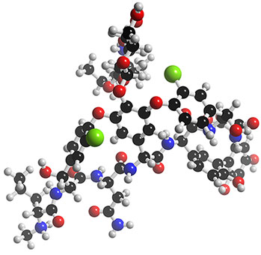
Vancomycin Pharmacodynamics & Pharmacokinetics
Clinical Orientation TDM Session
Date: June 2014

Slide 2
Objectives
Review pharmacology of vancomycin
Become familiar with pharmacodynamic properties
Including toxicodynamics
Review pharmacokinetic properties of vancomycin
ADME
Work through cases which highlight common pitfalls in vancomycin monitoring
Notes:
2

Slide 3
Outline
Vancomycin
Pharmacology
Pharmacodynamic properties
Pharmacokinetic properties
Toxicity/Adverse Effects
Clinical Use
Dosing
Therapeutic drug monitoring
Applied pharmacokinetics/cases

Slide 4
Vancomycin History Lesson
Derived from the word “vanquish”
Obtained from Streptomyces orientalis
Isolated 1956: Picric acid precipitation from Borneo soil sample
Prior to 1986: Purity 80 - 90%
After 1986: Purity increased to > 90%
Notes:
Pictures on next slide demonstrate color variation

Slide 5
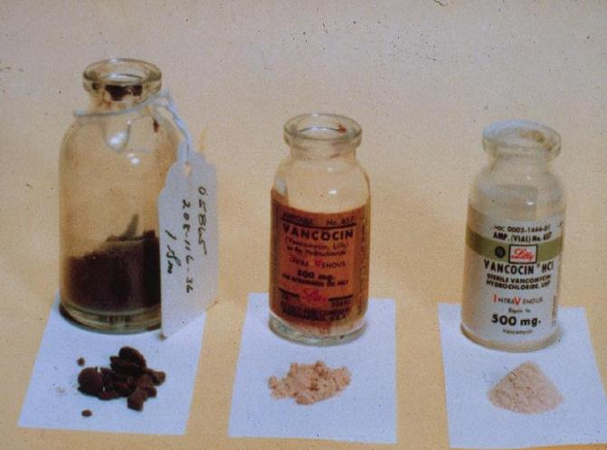
“Mississippi Mud”
5
Notes:
5

Slide 6
Mechanism of Action
Inhibits bacterial cell wall synthesis
Also alters permeability of cell membrane

Slide 7
Spectrum of Activity
Active against virtually all Gram positive organisms
including anaerobes, e.g. C. difficile
Resistance developing in some
Enterococci
Staphylococci
Note that Enterococcus faecalis has lower MIC than faecium

Slide 8
Pharmacodynamics
Time dependent bacterial kill
Best described as the ratio of area under the curve to the MIC (AUC/MIC)
However AUC not practical to measure in clinical practice
Total exposure (AUC) over 24h period vs. MIC should be optimized
Continuous infusion theoretically best but not demonstrated in trials
Maintaining trough levels 4-6 x MIC appears ideal
S. aureus S breakpoint for vancomycin is ≤ 2 mg/L
Notes:
8

Slide 9
Pharmacodynamics
Slow bacterial kill
May even appear bacteriostatic against some isolates
Inoculum dependent
less effective with larger inoculum
more aggressive therapy may be warranted

Slide 10
Pharmacokinetics: Absorption
Oral absorption generally poor
Vanco does not cross gut wall well
Oral doesn’t reach systemic circulation
IV doesn’t reach gut
Inflamed gut wall may significantly increase absorption
Can achieve serum levels 3-12 mg/L in C. diff colitis
Notes:
10

Slide 11
Pharmacokinetics: Distribution
V_{dss} = 0.5 - 1 L/kg (Mean = 0.7 L/kg)
Protein Binding: up to 55%
Large molecule so crosses membranes poorly
MW = 1449.22 Daltons
Long distribution phase
So have to wait at least an hour after dose for distribution to be complete (& levels drawn)
Notes:
11

Slide 12
Not here…
i.e. want to draw peak levels here…
Schematic representation of a 2-compartment PK model, wherein C = concentration, a and b = respective elimination constants, e = base of the natural logarithm, t = time, A and B = respective zero time intercepts for a and b, Ko = infusion rate constant, Vc =volume of the central compartment, Vp =volume of the peripheral compartment, K12 and K21 = intracompartmental rate constants, and KEL =elimination rate constant from the central compartment.
Notes:
12

Slide 13
Pharmacokinetics: Distribution
Enters most body tissues well but relative concentrations vary
CSF penetration requires inflamed tissues
Uninflamed meninges: 0-18% crosses BBB
Levels = 0-3.45 mg/L
Inflamed meninges: 36-48% crosses BBB
Level = 6.4-11.1 mg/L
Lung penetration variable
“Healthy” patients 40-50% of serum levels
Critically ill patients blood:lung fluid ratios 6:1

Slide 14
Pharmacokinetics
Metabolism
Virtually none
Some nonrenal clearance occurs in ESRD
Excretion
80 - 90% eliminated unchanged in the urine
Notes:
14

Slide 15
Adverse Effects of Vancomycin
Highly published, but possibly overstated
Literature from 1956-1992
2 major & 6 rare adverse effects
Major adverse effects of ototoxicity & nephrotoxicity
Likely reflect the OLD formulation

Slide 16
Ototoxicity
Traditionally associated with levels 80 - 100 mg/L
Based on 1 (? 2) patients from a 1958 case report
IF it occurs, it is rare and may have been related to impurities in the original formulation
Appears to be reversible with withdrawal of drug
Current literature refutes the existence of ototoxicity

Slide 17
Nephrotoxicity
Over half of the reports of nephrotoxicity appear in the literature in the first 6 years after the drug’s discovery
More recent studies: probability likely 5 - 15%
Combined with an aminoglycoside: 22 – 35%
Nephrotoxicity debate of vancomycin has come full circle…
may be a concern again, particularly with higher target trough ranges
Notes:
17

Slide 18
Major Findings:
Sig. difference in nephrotoxicity among patients on ≥ 4 g/d vs
< 4 g/d vs linezolid
34.6%, 10.9%, 6.7%
(p=0.001)
May actually reflect risk associated with increased trough levels
-Mean troughs were 18.9 mg/L (≥ 4 g/d ) vs. 12.4 mg/L (< 4 g/d)
Notes:
18

Slide 19
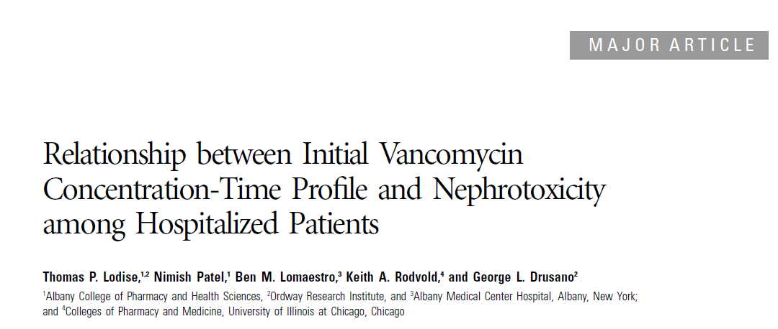

Major Findings:
Retrospective review (166 patients)
Compared initial level with nephrotoxicity (inc 0.5 mg/dL or 50%) in hosp patients
Found correlation between higher troughs and nephrotoxicity
Notes:
Methods:
Restrospective study – pts with suspected or proven GP infection (Jan 2005-Dec 2006) Albany Med Centre
Inclusion:
Adult (18 or older)
ANC greater than/equal 1000 cell/mm3
Vanco at least 48 h
Vanco trough level done at least once – and done within 96 h of initiation
Baseline SCr of less than 2 mg/dL
Exclusion:
CF
IV contrast dye within 7 d
Vasopressors during therapy

Slide 20
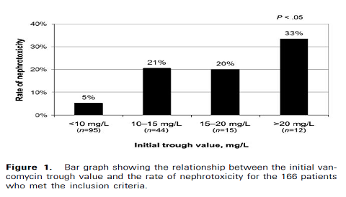
Notes:
CAUTIONARY NOTE: Pictures are pretty but this is a single site, retrospective review of small patient size. As mentioned by the authors, further multicentre, prospective trials would be nice.
None the less, we could use to discuss to real possibility of nephrotoxicity, and highlight the difference as trough levels creep higher than 20 mg/L.

Slide 21
Adverse Effects
Red Man Syndrome (aka Red Neck Syndrome)
From rapid IV infusion
Histamine release causing
Flushing/tingling
Tachycardia, hypotension
Pruritus & erythematous macular rash involving the face, neck, upper trunk, back and arms (typically sparing the rest of the body)
Slowing infusion rate, or giving smaller doses more frequently, reduces frequency and severity of this
Also may consider pre-meds
Notes:
21

Slide 22
Adverse Effects
Phlebitis
around 10% with modern formulations
Neutropenia (~2%)
Thought to be dose AND time dependent
may occur independently of both of these factors
Incidence increases to 17% after > 14 days of therapy
Usually delayed onset (15-40 days)
Reversible on discontinuation
Notes:
Pai et al. Annals of Pharmacotherapy 2006.
22

Slide 23

Vancomycin Use in Therapy
Vancomycin resistance relatively rare
But do see “creeping up” of vancomycin MICs in susceptible strains post-exposure to vancomycin
Clinical failure increasingly common
Developing resistance (VRE, VRSA, GISA, etc.)
Exposure at site of infection
Poor penetration into lung, CNS, abscesses and/or
vegetations > 2 cm
Consider trough levels at site of infection, not just blood
Notes:
23

Slide 24
Vancomycin Resistance
Different levels of resistance, majority of them intermediate or variable
TRUE resistance RARE – less than a dozen in whole world
Characterised by prolonged glycopeptide therapy
Increased risk of treatment failure
Associated with resistance to daptomycin
Notes:
24
24

Slide 25
Vancomycin & Staphylococci
Note differences between Staph species
MIC breakpoint for S. aureus was lowered several years ago, in recognition this is a more difficult infection to treat successfully.
S. aureus
Susceptible: MIC ≤ 2 mg/L
Intermediate (VISA): MIC = 4-8 mg/L
Resistant (VRSA): MIC ≥ 16 mg/L
Coag-negative Staphylococcus
Susceptible: MIC ≤ 4 mg/L
Intermediate: MIC = 8-16 mg/L
Resistant: MIC ≥ 32 mg/L
Notes:
25
Having a higher MIC breakpoint does not imply an organism harder to treat but rather one that is easier to treat. The breakpoints are based on when clinical failure is seen in treatment relative to the achievable MIC of the treating drug.

Slide 26
Vancomycin Dosing: Neonates
Neonates ≤ 44 weeks Post-Conceptional Age (PCA)
INITIAL DOSE: 10-15 mg/kg/dose q 8-24h
depending on gestational age, post-natal age, post-conceptional age and/or weight of the neonate
Refer to local dosing references for local practice
extend dosing interval if renal dysfunction suspected
i.e. SCr > 65 umol/L or UO < 1 mL/kg/h
then adjust according to trough levels

Slide 27
Vancomycin Dosing: Pediatrics
Children > 44 weeks up to 1 year | 40-60 mg/kg/day, divided q6-8h
Children 1 – 12 years | 60 mg/kg/day, divided q6-8h
Children/Adolescents > 12 years | PK parameters will transition to become increasingly like those of adults. Consideration of the age of the child and the severity of illness needs to be made when choosing an initial dose between 30-60mg/kg/day divided into a q6h, q8h, or q12h interval.

Slide 28
Vancomycin Dosing: Adults
15 mg/kg/dose of TOTAL BODY WEIGHT (TBW) to an empiric maximum of 2 g/dose
Can consider loading doses (25-30 mg/kg) to achieve target levels more quickly:
severe infections
renal dysfunction
Initial dosing interval - Derive from creatinine clearance
Notes:
28

Slide 29
Creatinine Clearance: Stable Renal Function
Cockcroft & Gault
a) Male Clcr= 140 – Age (BW)
(Cr/88.4)72
b) Female: Clcr Male * 0.85
Limitations of CG:
1. No females in study.
2. No > 65 yo in study.
3. No muscle wasting or
neurological disease.

Slide 30
Determine Interval from Chart
Bugs & Drugs 2012: Vancomycin Dosing Guidelines
B) Adults
2. Dosing interval determination:
Notes:
30

Slide 31
Dosing at Low ClCr
ClCr < 30 mL/min
Likely require a pharmacokinetic consult
See next couple slides re: determining dosing interval
ClCr < 10 mL/min
Likely on renal replacement
PD, IHD, CRRT
Refer to dosing guidelines for each modality

Slide 32
Determining Interval from Calculation
k_{eVancomycin}= 0.00083(CLcr) + 0.0044 h⁻¹
Tau (interval) = ln (C_{max}/C_{min})
k_{e}
Can also estimate t_{1/2} from K_{e}
helps confirm recommended dosing interval
t_{1/2} = 0.693/k_{e}
Tau = 2 x t_{1/2}
helps determine time to steady state* and when trough level should be drawn (* Steady state occurs in 4-5 half lives)

Slide 33
Vancomycin Monitoring
Routine monitoring of vancomycin levels is NOT recommended because there is:
little literature evidence to support it
no clear evidence that toxicity is reduced by stricter adherence to specific concentration ranges
However…Increasing need for trough levels with higher targets

Slide 34
Vancomycin Monitoring
Who to do trough levels in:
Deteriorating/unstable renal function
⇑ SCr ≥ 40 mcmol/L or 50% baseline
Morbidly obese patients
> 190% IBW or BMI ≥ 40 kg/m²
Altered V_{d} or clearance of drug
CF, pediatrics, elderly, cancer, burns > 20% BSA
Anticipated therapy ≥ 7 days
Severely ill patients or those requiring higher trough
CNS, IE, pneumonia, osteomyelitis, sepsis, serious MRSA infections
Selected dialysis patients
Notes:
34

Slide 35
Vancomycin Monitoring
Vancomycin trough levels
Collect specimen 30 min or less before next dose
First level in 1-2 days and after at least 2 doses
Don’t rush
Longer you wait = closer to steady state
Avoid weekends/middle of the night
May be helpful to suggest “before Monday morning dose” rather than “before 5th dose”
If has to be on the weekend, document plan clearly for others to follow-up
Some patients may need level sooner
Obese patients, high renal function (peds)
Subsequent levels once/week
Notes:
35

Slide 36
When to Target 15-20 mg/L
Pneumonia
Bacteremia
Osteomyelitis
CNS infections
Infective endocarditis (IE)
“Serious deep seated infections”
MRSA – still need to consider site of infection
Target 10-20 mg/L for other infections

Slide 37
Vancomycin Monitoring
Peak (post) levels are NOT generally indicated
Peaks do not correlate to clinical outcome or bacterial eradication (AUC/MIC does)
3-compartment model makes it difficult to identify the true peak
Notes:
37

Slide 38
Vancomycin Monitoring
Serum creatinine
Baseline & once weekly
more frequently based on patient condition
If creatinine changes need to re-evaluate dosing
suggest drawing a trough level
CBC with differential
Baseline & once weekly

Slide 39
The “Pharmacokinetic Consult”
Decide on interval based on renal function:
Calculate ClCr using Cockcroft-Gault &
a) use Bugs & Drugs table, or
Equations:
k_{eVancomycin}= 0.00083(CLcr) + 0.0044 h⁻¹
Tau = ln (C_{max}/C_{min})
k_{e}
Decide if trough level required for monitoring
Arrange for serum creatinine +/- vanco trough
Notes:
39

Slide 40
TDM Tips:
If desired, one can estimate k_{e} and t_{1/2}
helps confirm recommended dosing interval
helps determine time to steady state* and when trough level should be drawn * Steady state occurs in 4-5 half lives)
k_{e} (est) = CrCl*0.00083 + 0.0044
t_{1/2} = 0.693/k_{e}
Notes:
40

Slide 41
TDM Tips:
When to draw first level (if needed):
If proper dose has been ordered to initiate therapy, there is no rush to order first level and the longer you wait the greater the chance of ensuring steady state.
Avoid weekends.
Instead of ordering a level with “X dose”, consider ordering a level prior to “X-day morning’s dose”.
Reduces chance that patient will be woken to have a level drawn in the middle of the night when there is no need to do so.

Slide 42
TDM Tips:
If weekend levels can not be avoided, document your recommendations and plan for your patient based on what the level may be.
Reduces the stress on the weekend staff to figure out who this patient is and what the targets are.
Ensures your patient is maintained on the therapy you have planned for them.

Slide 43
Remember to document! Example:
Patient (70 y.o.) is currently on day 2 of vancomycin 1 g IV q12h for the treatment of MRSA osteomyelitis. Patient weight is 80 kg and SCr is 90 mcmol/L (CrCl(est) ~ 75 mL/min). Target trough level is 15-20 mg/L. A trough level has been ordered for this patient prior to Sunday morning’s dose. Given patient demographics, expect level to be at steady state by Sunday, and come back at approximately 12-13 mg/L. If level on Sunday is less than 13 mg/L, recommend increasing dose to 1.25 g IV q12h for a 25% increase in trough level.
I.M. Smart BScPharm (445-5555)

Slide 44
Adjusting Dose Based on Levels
Trough too low
Shorten dosing interval or
Increase dose
Trough too high
Extend dosing interval
or
Decrease dose
Remember that vancomycin exhibits first order kinetics
Changes in dose will result in proportional changes in the level
Dose₁ ₌ Dose₂
Conc’n₁ Conc’n₂
And to repeat levels on new dose, as needed

Slide 45
VANCOMYCIN TDM CASES
So now that we’ve reviewed the PK and PD it’s time to practice your new skills

Slide 46
TDM Problem #1
Most common scenario:
trough level drawn on a given regimen
need to make recommendation for appropriate dosage
Can’t do PK calculations
*** Important to remember that vancomycin follows 1st order kinetics so you can use a ratio to make your recommendation. ***

Slide 47
TDM Problem #1
A 24 year old patient is admitted to your team with a chronic osteomyelitis secondary to a MVA 2 years ago. Drainage from the wound as well as the bone chip grows coagulase negative Staphylococcus. A trough level drawn 3 days into therapy of vancomycin 1000 mg IV q12h comes back at 12 mg/L. Target trough level is 15-20 mg/L.
Is vancomycin the right drug, and if so what dose would you recommend?
Notes:
47

Slide 48
TDM Problem #1
What is your expected trough level from new dose?

Slide 49
TDM Problem #2
R.M., a 92 y.o. female (53 kg, 5’2”) has been started on vancomycin 500 mg IV Q6H for an infection of a left heel ulcer.
C&S of left foot wound shows Enterococcus faecalis and Coagulase negative Staph (Staphylococcus epidermidis), both susceptible to vancomycin.
Labs: SCr = 58 µmol/L BUN = 14 mmol/L
Notes:
49

Slide 50
TDM Problem #2
Based on the clinical information available, is vancomycin the appropriate antimicrobial choice for this lady?
What would be an appropriate dosage regimen for this patient?
Notes:
50

Slide 51
TDM Problem #2
3. What is the expected Cmax and Cmin on this new regimen?
4. When should levels be requested?
Notes:
51

Slide 52
TDM Problem #3
A 35 y.o. male (92 kg, 6’0”) has been started on vancomycin 1 g IV Q12H for treatment of endocarditis. C&S of blood shows methicillin resistant Staphylococcus aureus, susceptible to vancomycin. Endocarditis was confirmed by echocardiogram. Patient has a long history of injection drug abuse.
Labs: SCr = 72 μmol/L BUN = 5 mmol/L
Levels (3rd dose): post (peak) = 14 mg/L drawn at 1400H
pre (trough) = 3 mg/L drawn at 1155H
Time dose administered: 1200H
Notes:
52

Slide 53
TDM Problem #3
Is vancomycin the appropriate therapeutic choice for this patient? Why?
What is the patient’s k_{e} and t_{1/2}?
Notes:
53

Slide 54
TDM Problem #3
3. What is the patient’s Vd?
Notes:
54

Slide 55
TDM Problem #3
4. What new dosage regimen would you recommend if any?
Notes:
55

Slide 56
TDM Problem #3
5. What are the predicted levels with this new dose?
Notes:
56

Slide 57
TDM Problem #3
5. Would your interpretation of the levels differ if the peak came back at 25 mg/L and was taken at 1300H (rather than 1400H)?

Slide 58
TDM Problem #4
Based on previous high trough levels, a 68 y.o. male was on vancomycin 1750 mg IV Q12H for the treatment of a methicillin resistant Staphylococcus epidermidis infection of his left knee prosthesis. The knee was debrided but hardware retained.
Baseline Labs (10 Mar): SCr = 78 μmol/L
Pre (trough) = 36 mg/L (21 Mar@0915h; prior to 11th dose, but dose note given)
Level unexpected for patient’s weight (125 kg) and SCr.

Slide 59
TDM Problem #4
Is vancomycin the most appropriate therapeutic choice for this patient?
What would you recommend?
No further doses given
- Repeat level 22Mar 0930 = 25.6 mg/L
Notes:
59

Slide 60
TDM Problem #4
3. What new dosage regimen would you recommend?
Notes:
60

Slide 61
TDM Problem #4
4. When would you recommend starting new dosage regimen?
Notes:
61

Slide 62
Summary:
Remember to assess your patient before doing TDM:
Does the patient have an infection – and is vancomycin the right drug to treat it?
What is the clinical status of the patient – is patient improving, are markers like SCr stable, or reliable to use? Are levels at steady state?
How long does the patient need treatment? Are levels required? What are your targets?
Think about when you order levels – avoid overnight or weekend draws where able
The math is the easy part – you should have your plan first

Slide 63
Any Questions?
QUESTIONS?
Developed by: Margaret Gray,
with Susan Fryters, Deonne Dersch-Mills, Stacey Ginther, and Clara Tsang

